Slide 1




The IPACS model
A simulation tool for complex care pathways
HSMA Workshop: 7th February 2023
Feel free to introduce yourself in the chat box!
Dr Alison Harper
Dr Paul Forte
IPACS Project Team

Slide 2
Learning Objectives
Introduction to the IPACS complex care pathways simulation model and its operational context
Hands-on experience of the IPACS model
Considerations and experience of embedding the model with local stakeholders

Slide 3
Our agenda…
1330 - 1345 | Introductions, workshop agenda
1345 - 1405 | Introduction to IPACS and exercise 1
1405 - 1430 | Exercise 1 and feedback
1430 - 1435 | BREAK
1435 – 1455 | Introduction to Exercise 2
1455 – 1515 | Break out group: Exercise 2
1515 - 1530 | Discussion and evaluation
1530 | CLOSE

Slide 4
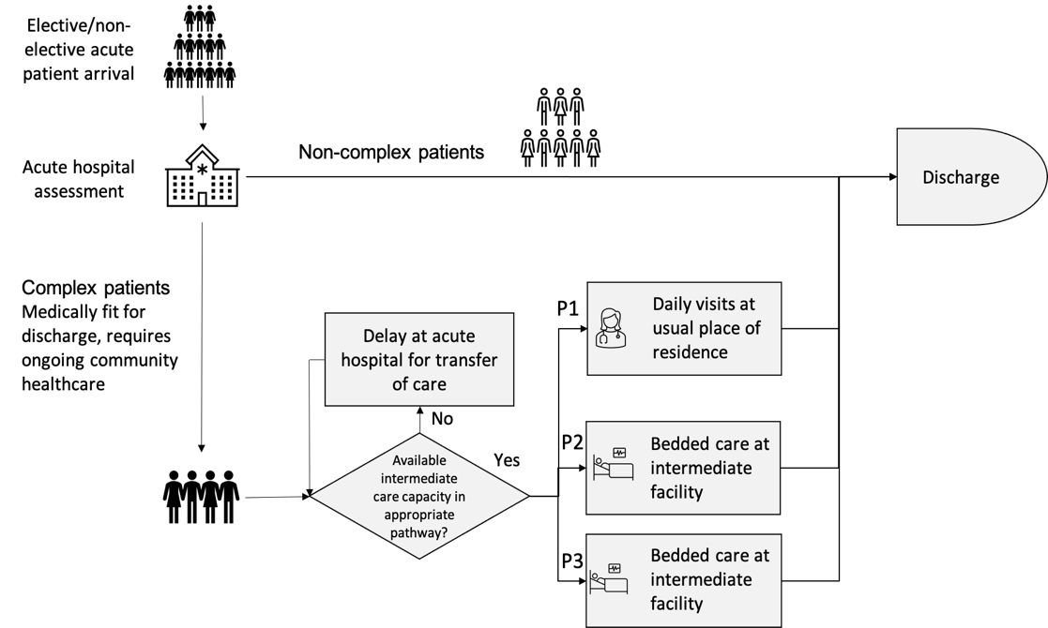
D2A: Complex care pathways
Admission
to hospital
Discharge
to home (potential long-term support)
Discharge from hospital:
potential delay if no capacity
in community pathways
Admission to complex care
pathways
Notes:
Only translate title and text in blue boxes: leave rest in English (or only translate if there’s time to; I wouldn’t worry about it). My intention is to animate the boxes one at a time as ai talk through the slide

Slide 5
Model variants
Bedded care
Care is provided in community hospital or care home beds
Length of Stay is variable
Each admitted patient consumes one service channel (bed) from admission to discharge
There are a fixed number of service channels (bed capacity)
Visits-based care
Care is provided at the patient’s own home through daily visits
Length of stay is variable
Each patient ‘consumes’ a different (reducing) number of daily home visits over their LoS
Capacity (max daily home visits) cannot be exceeded
The IPACS model addresses both of these modes of care

Slide 6

Parameters and outputs
Input Parameters
  Time horizon (e.g., 6 months, 1 year)
  Initial occupancy by locality, for each pathway
  Initial queue in the acute by locality, for each pathway
    medically fit for discharge, ‘no criteria to reside’ (NCTR)
  Capacity by locality, for each pathway
  Daily demand rate - Poisson arrivals
  Initial and final number of visits per patient per day for visits-based care (P1)
  Mean/median LoS for bedded care (P2 and P3)
Output Report
  Routine report in Microsoft Word generated via Rmarkdown
  Summary of inputs
  For each locality and each care pathway: a set of plots which display all combinations of scenarios for:
    Number of patients in service - the number of patients estimated to be utilising the service given service capacity;
    Number awaiting service - the number of patients estimated to be delayed in the acute sector awaiting a D2A pathway;
    Mean days delayed - the mean number of days a patient is delayed in the acute sector.
    Costs - total system cost (acute delay cost + community service cost)
IPACS Simulation tool

Slide 7
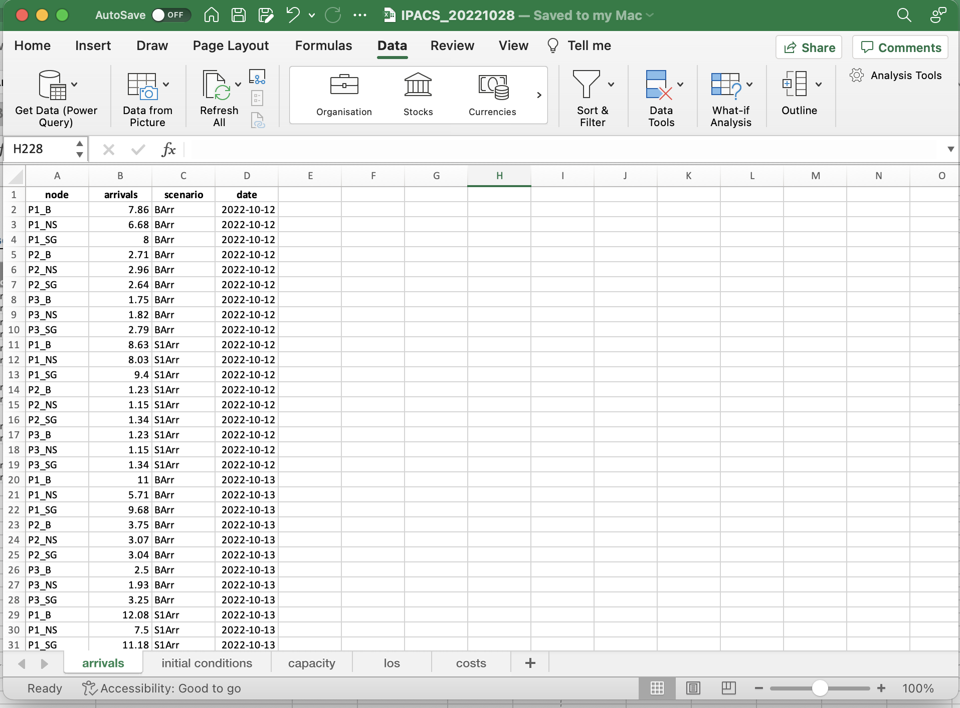
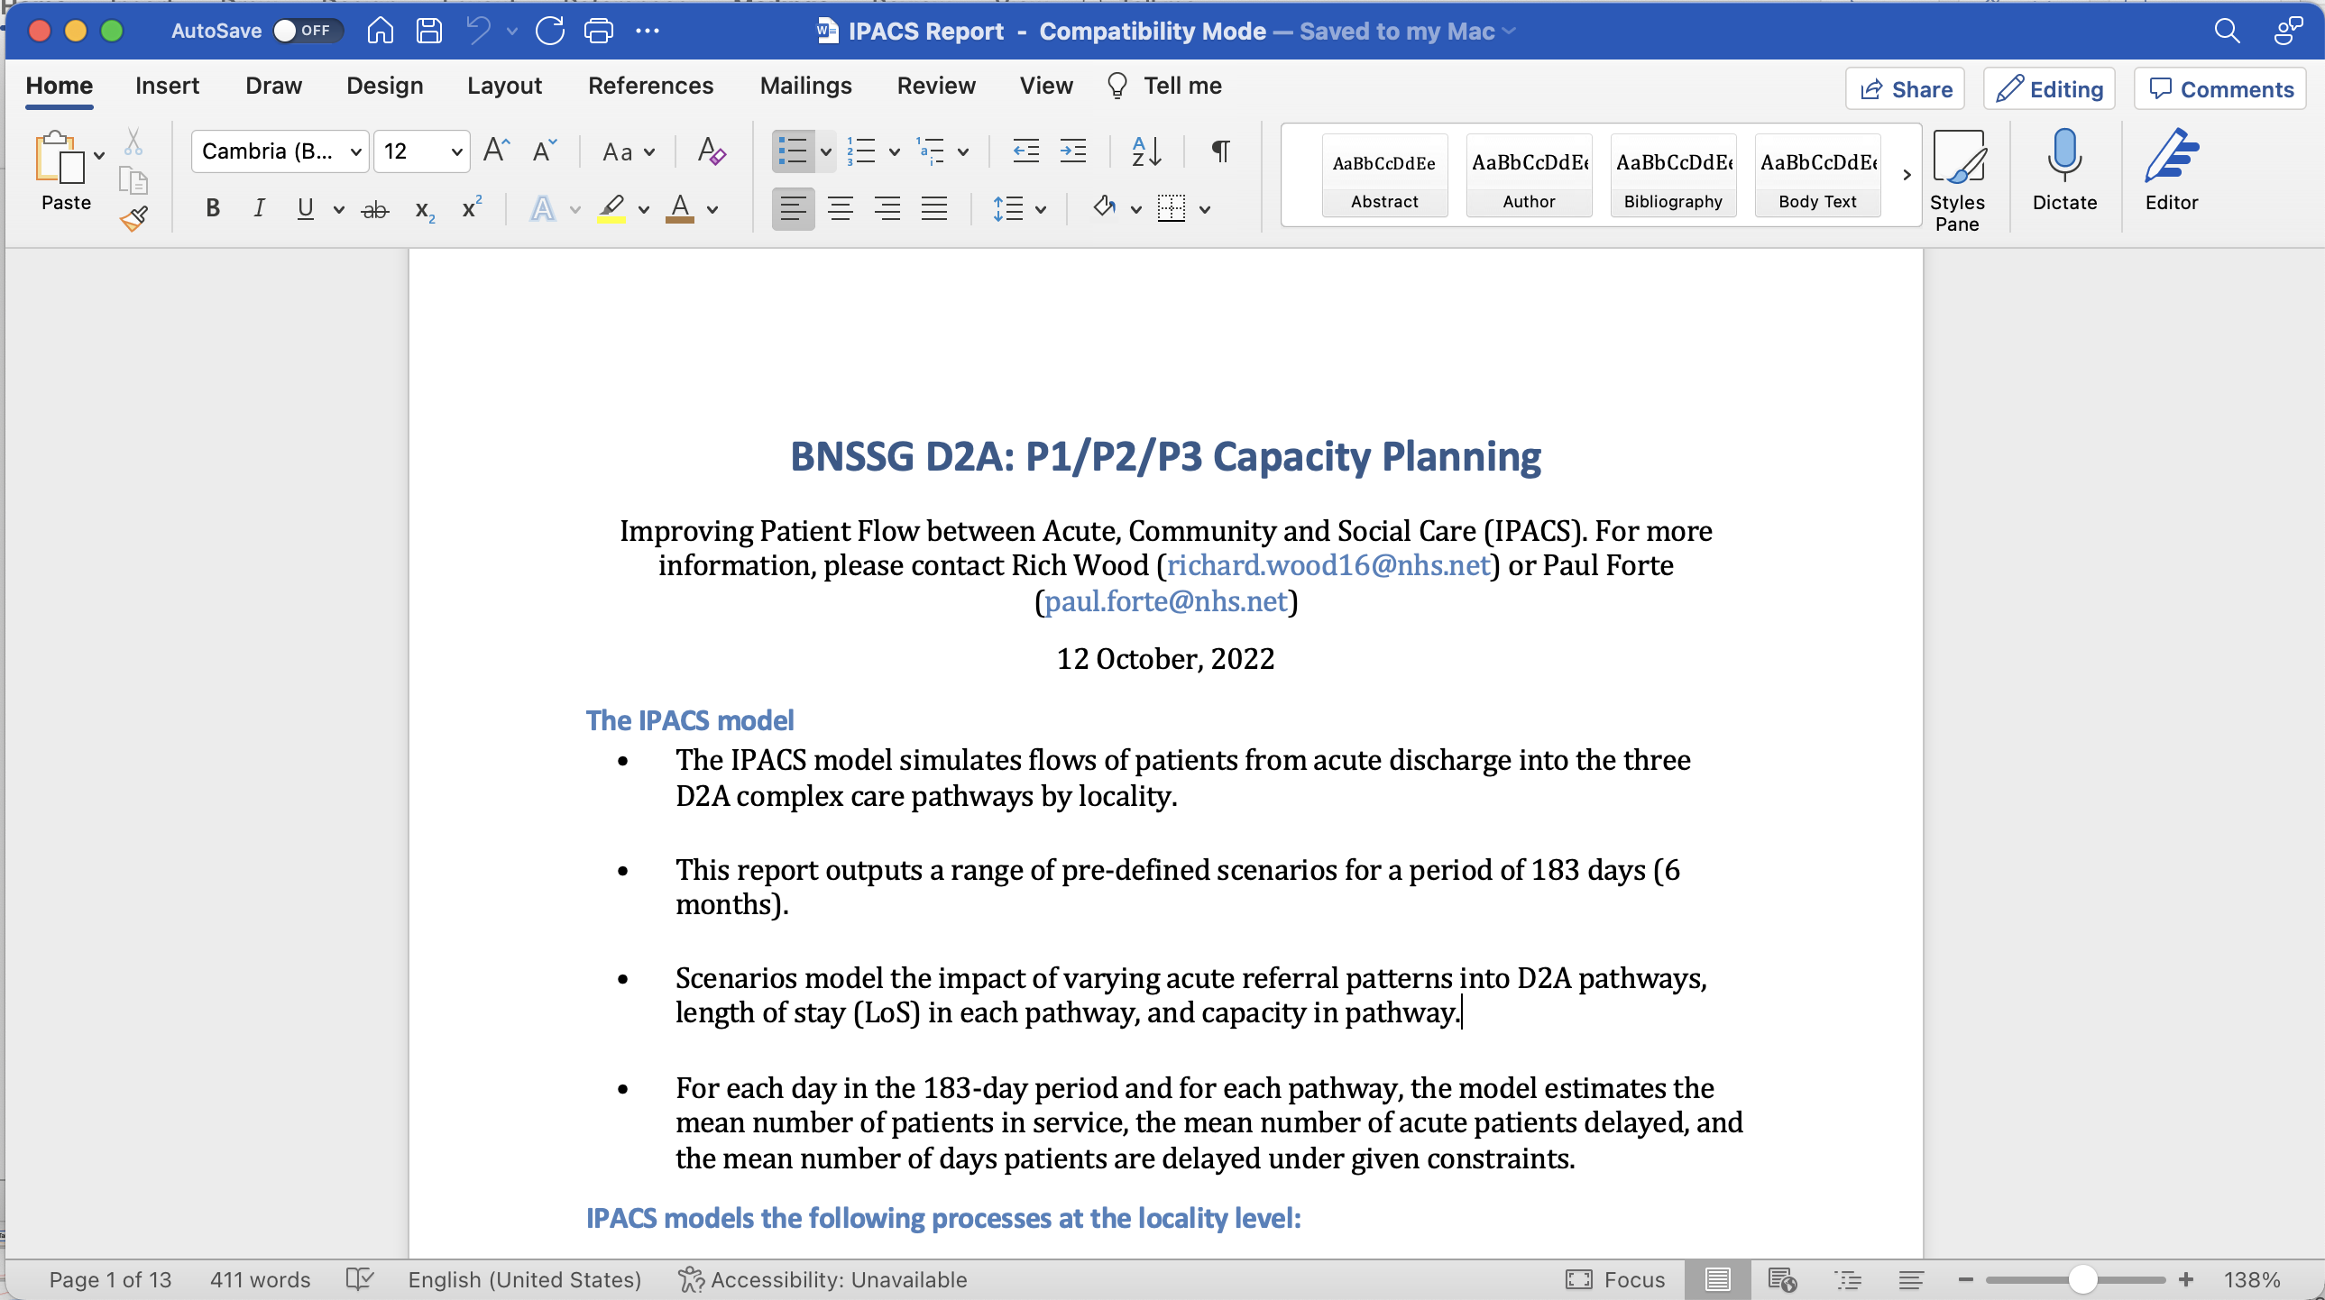
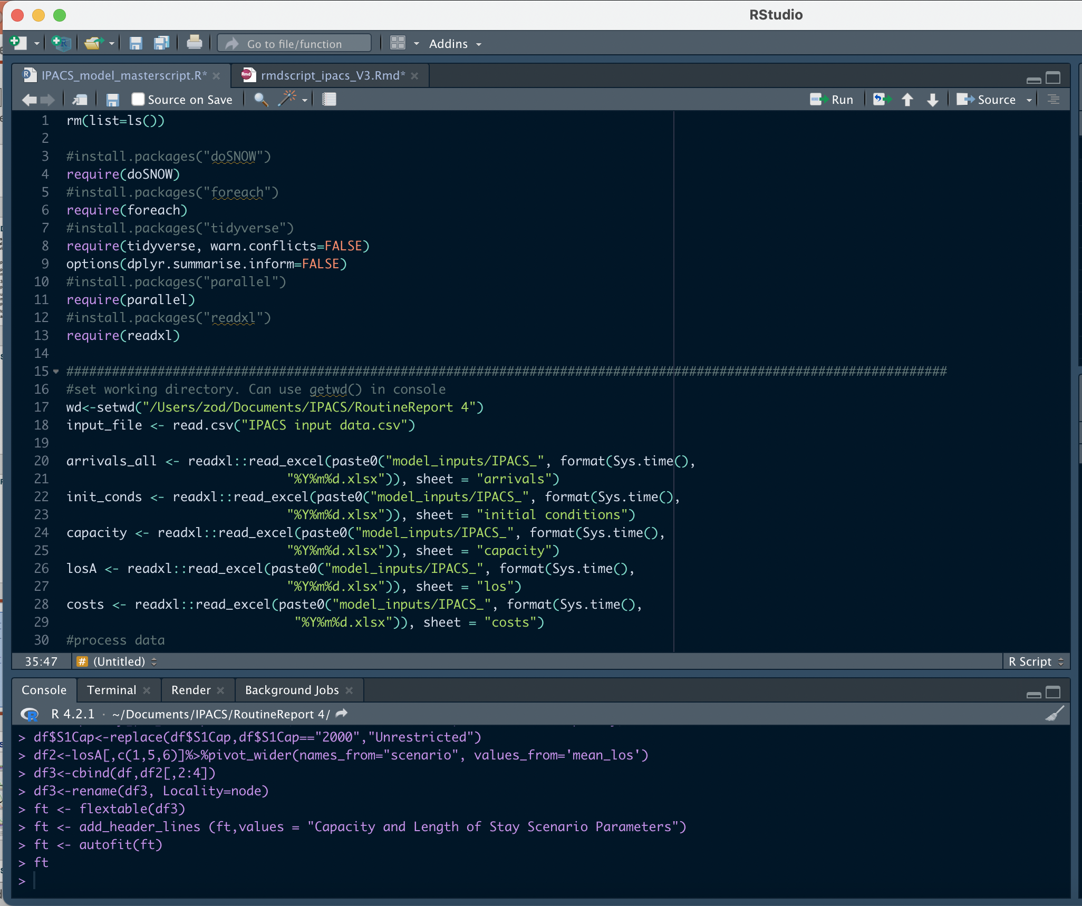
Input Parameters
Output Report
IPACS Simulation tool

Slide 8
Over to you – Exercise 1
Alison will step you through the model, explaining its structure and data inputs through two illustrative, hands-on exercises. Follow along for yourselves, copying the steps using the version of the model you have downloaded.
We’ll leave you to have a go for yourself for 10 minutes or so.
We’ll be around to answer questions/ help out (via chat box) and, at the end, we’ll run through some answers with you.

Slide 9
Exercise 1a - demo
Step 1: Download the IPACS Exercise 1a folder.
Step 2: Launch ‘Rstudio’.
Step 3: Open the file: IPACS_model_masterscript_exercise1a.R.
Step 4: Set the directory for your input files:
    In the console window (bottom left window) set the ‘working directory’. (This enables the model to locate your data files folder).
    Navigate to the folder where you downloaded IPACS Exercise 1a, right-click on Settings wheel icon, and click ‘Set as working directory’
    Copy the output produced by this command to “setwd(“C:/Users…”)” in the script window (‘top left’ window).

Slide 10
Exercise 1a - demo
Step 5: Run the IPACS model
    Run the script Code->Run Region-> Run All
Step 6: Results
    Take a look at the report IPACS Report Exercise 1a.docx in the IPACS Exercise 1a folder. You can also look at the .csv files in outputs folder.

Slide 11
Exercise 1b – over to you
Step 1: Download the IPACS Exercise 1b folder.
Step 2: Open the Excel file: IPACS_exercise1b.xlsx
Step 3: Now, imagine you would like to add a new scenario which increases the capacity for all pathways and localities by 10%. How would you do that?
(Hint: You need to add new rows in the capacity sheet. Call the new scenario “S1Cap”).
    Enter the values (or you could use a formula).
    Save the document and close it.

Slide 12
Exercise 1b – over to you
Step 4: Open the file: IPACS_model_masterscript_exercise1b.R.
Step 5: Set the directory for your input files:
    In the console window (bottom left window) set the ‘working directory’. This enables the model to find the folder where your data files are held.
    To do this navigate to the folder where you downloaded IPACS Exercise 1a, right-click on Settings wheel and click on ‘Set as working directory’
    Copy the output produced by this command to “setwd(“C:/Users…”)” in the script window (top left window).
Step 6: Run the IPACS model
    Run the script Code->Run Region-> Run All
Step 7: Results
    Check the report IPACS Report Exercise 1b.docx in the IPACS Exercise 1b folder. You can also check the .csv files in outputs folder.

Slide 13
Feedback – session 1
You’ve now been taken through the model and had an opportunity to try if out for yourselves… how did you get on?
Your initial impressions of the IPACS model…such as…
    its relevance?
    its ease of use?
    any areas of confusion to clear up?

Slide 14

Take 5…
10-minute break

Slide 15
IPACS - model implementation
In this part of the workshop we’ll focus more on the application and implementation aspects of the IPACS model including:
  model implementation considerations
  the IPACS experience in BNSSG
We’ll then proceed to Exercise 2 where you can work through in your groups on an exercise, and we’ll finish with an evaluation and plenary feedback session.

Slide 16
An embedding strategy for models
Technical Competence & Capacity
  Technical domain experience: simulation modelling/ coding expertise
  Model validation and testing
  ‘Peer-approval’ from other analysts/ experts
Contextual Awareness
  Correct identification of model requirements and system drivers
  Contextual domain experience
  Stakeholder liaison/ politics/ reassurance
Takes much more time than modellers usually like…
Very important for establishing and maintaining credibility and confidence
Notes:
Translate full page (or at least main sense)

Slide 17
IPACS in BNSSG…
Support input to business case for local system investment of £13m into D2A strategy
D2A Implementation Group – further scenario modelling support into 2023/24
Multi-organisational involvement: ICB, Community Health, and three Local Authorities including:
    community health and social care professionals
    operational and strategic management and finance

Slide 18
Over to you – exercise 2
Exercise 2 provides you with a fresh version of the model which will automatically read in your input files:
  From GitHub, download and save Exercise 2 files into a local folder
  Open the Word document ‘Exercise 2 Instructions’
Your objective is to come up with a scenario which:
  reduces both the numbers of patients delayed, and their average queue waiting time
  minimises costs
We’re keeping it simple so, in this exercise, you can only vary:
  average length of stay by pathway and locality
  pathway capacity by locality
(In this exercise, we assume you can’t vary patient arrival rates).

Slide 20

Workshop evaluation form
In the chat box you will find a link (or follow the QR code here) to an evaluation form which we’d be grateful if you would take 5 minutes now to complete for us.
When you’re finished just click on the submit button at the bottom of the survey form.
We appreciate that you may have further comments or queries post-workshop. If so, please drop a line to Alison at a.l.harper@exeter.ac.uk

Slide 21
Plenary: your reflections…
Your opportunity – in person or in chat box - to feedback to us:
  Reasons for choice of parameter values?
  What might be involved in implementing any parameter value changes you have made?
  What might be implications for timescale, health and social care resources?
  Your initial impressions of the IPACS model as a decision support tool

Slide 22
Thanks for attending - we hope you enjoyed the workshop!
You want to follow-up? a.l.harper@exeter.ac.uk
Alison and Paul

